Slide 1
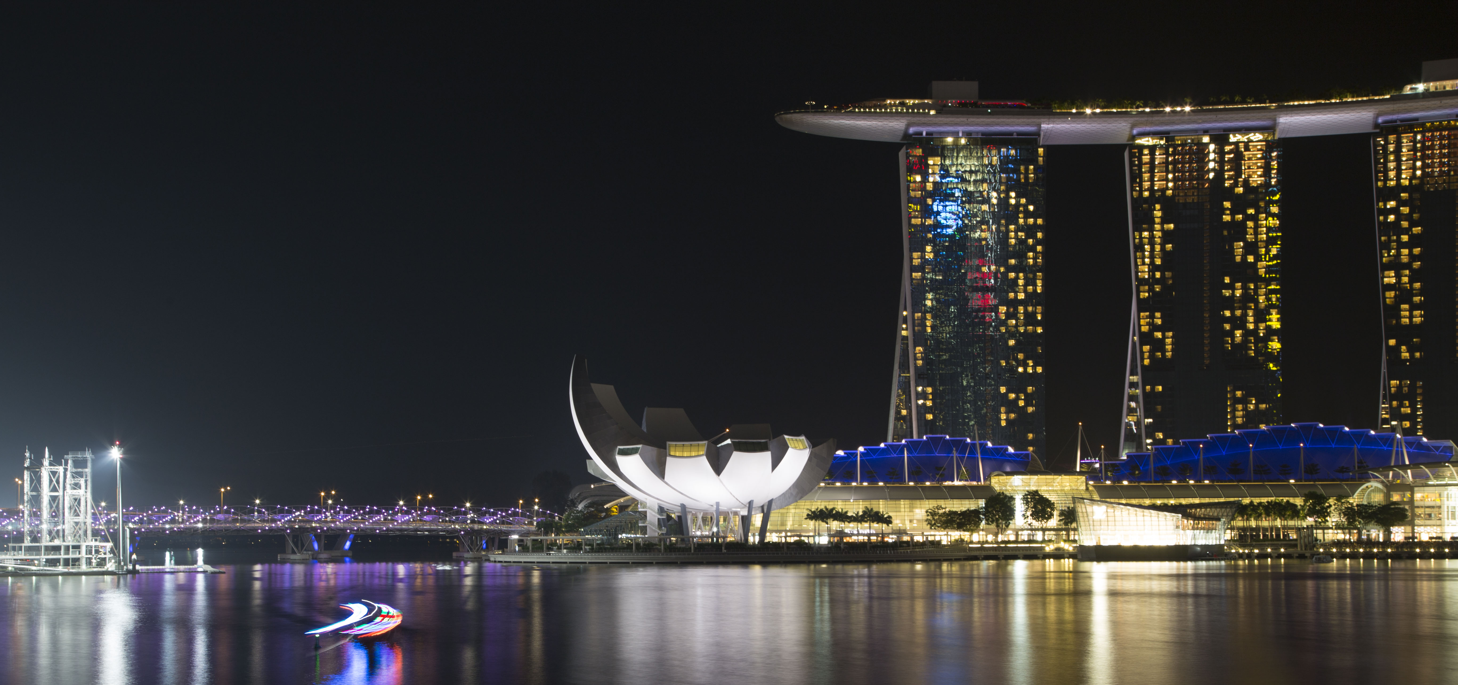





PowerShell on IoT
PowerShell Conference Asia
- Rakesh K. Kethineedi

Slide 2
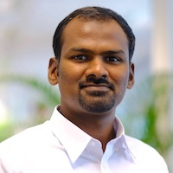

About Me
Automation advocate
Passionate about PowerShell
Works at Robert Bosch, Singapore
Co-organizer of Singapore Veeam User Group
Twitter: @rakeshkarthikk
Blog: http://rakeshkethineedi.blogspot.sg/
PowerShell Conference
Singapore 2017

Slide 3
Understanding the audience’s expectation
How many of you can explain about IoT in simple terms?
How many of you have done a project on IoT before?
PowerShell Conference
Singapore 2017

Slide 4
IoT Introduction
The Internet of things (IoT) is the network of physical devices embedded with electronics, software, sensors and network connectivity which enable these objects to collect and exchange data.
https://www.youtube.com/watch?v=d55rBuB9D7s
PowerShell Conference
Singapore 2017

Slide 5
Prerequisites
Prerequisites:
Basics of Powershell remoting
PowerShell Conference
Singapore 2017

Slide 6
Demo
PowerShell Conference
Singapore 2017

Slide 7
WHAT IS RASPBERRY PI ?
PowerShell Conference
Singapore 2017

Slide 8
Setup
Raspberry Pi is flashed with Windows 10 IOT Core OS.
Reference: https://developer.microsoft.com/en-us/windows/iot/getstarted
Connect a display using HDMI cable.
Deploy an app to the Raspberry Pi using Visual Studio 2017 community edition.
PowerShell Conference
Singapore 2017

Slide 9
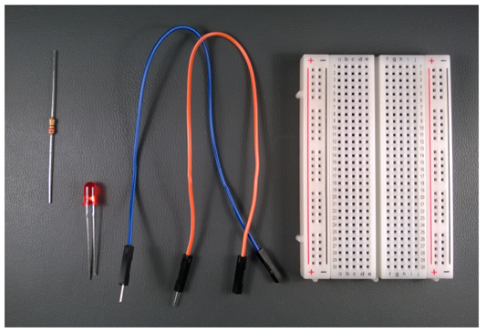
Circuitry
PowerShell Conference
Singapore 2017

Slide 10
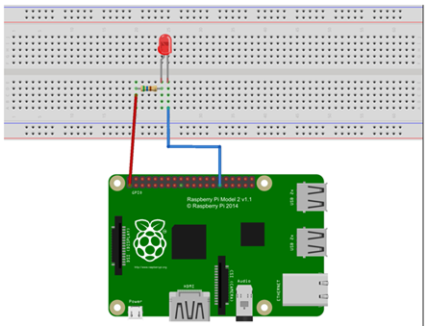
Connection
Demo
PowerShell Conference
Singapore 2017

Slide 11
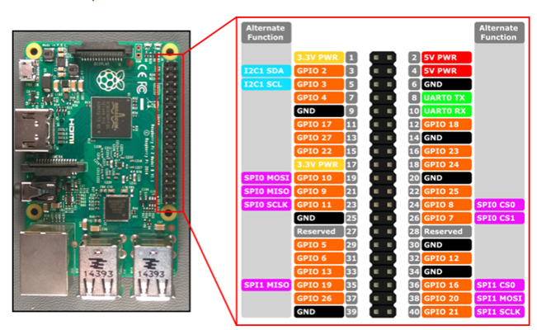
Raspberry Pi 3 Pins
Demo
PowerShell Conference
Singapore 2017

Slide 12
Hardware
Raspberry Pi
Sensors / LED, Resistor and Connection wires
SD card:
Minimum 8GB
HDMI cable
PowerShell Conference
Singapore 2017

Slide 13
Steps
Windows 10 IoT core - https://developer.microsoft.com/en-us/windows/iot/GetStarted
Setup the device – Download and install Windows 10 IoT Core Dashboard
PowerShell Conference
Singapore 2017

Slide 14
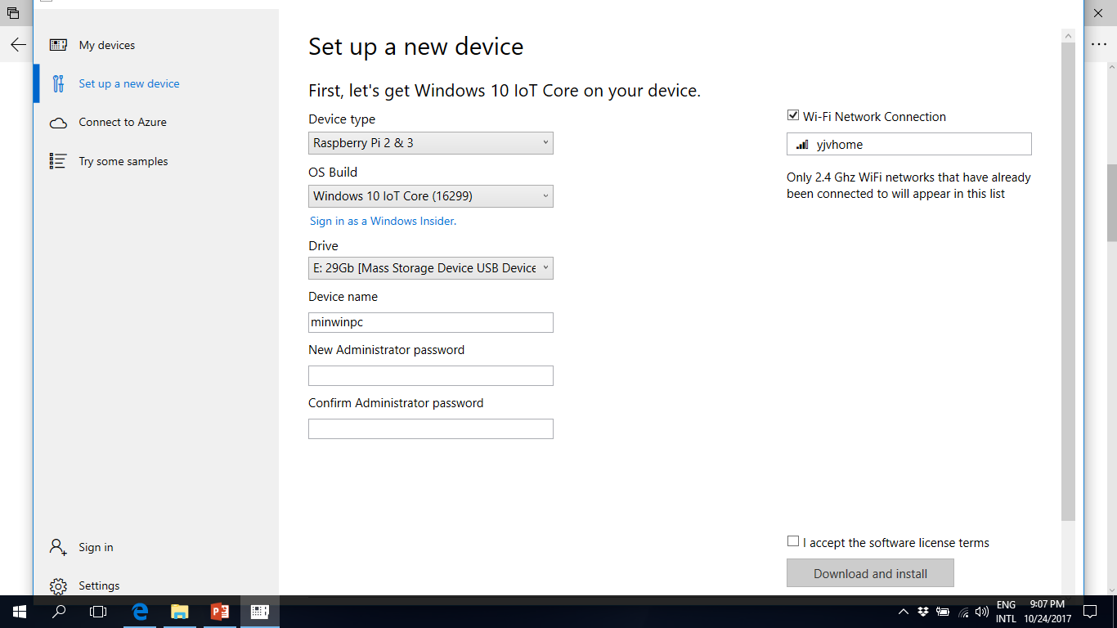

Slide 15
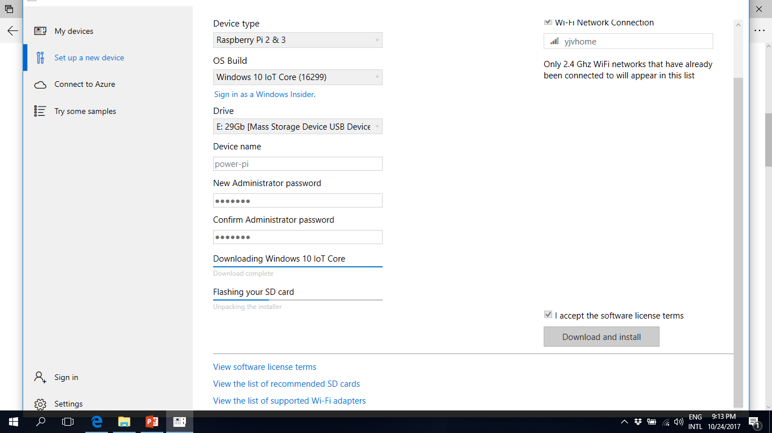

Slide 16
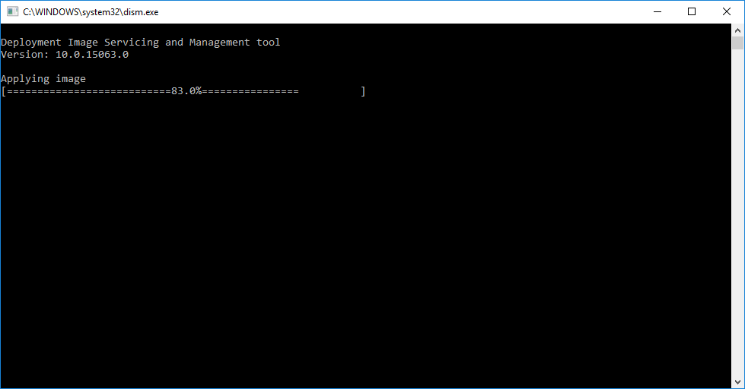
PowerShell Conference
Singapore 2017

Slide 17
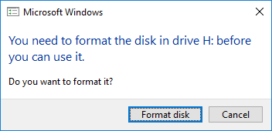
Click Cancel
PowerShell Conference
Singapore 2017

Slide 18
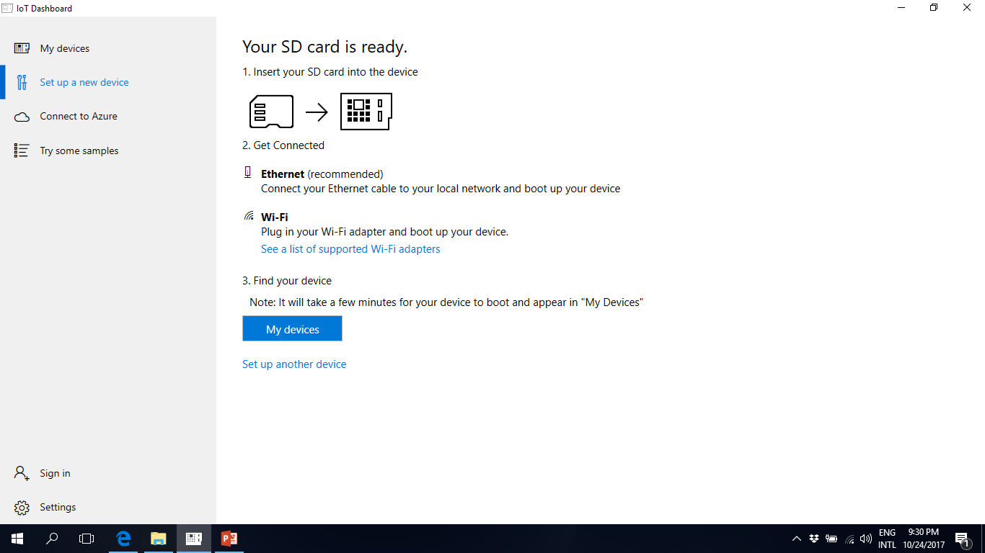

Slide 19
Setup Visual Studio
Install VS2017 with UWP and IOT SDK
If you plan to use Grove Pi kit from Microsoft, perform the below steps.
Download Grove Pi samples from https://github.com/DexterInd/GrovePi/tree/master/Software/CSharp/Samples
Open a solution and goto Tools -> NuGet Package Manager -> Package Manager Console and execute the command “Install-Package GrovePi”
Right click the solution and goto Properties -> Debug and add Target device as “Remote Device”.
Debug mode – Select Remote machine as the Raspberry Pi
Build and deploy the solution on to the Pi.

Slide 20
PowerShell Connection
Launch Powershell as Administrator
net start WinRM
Set-Item WSMan:\localhost\client\TrustedHosts -Value <raspberrypi-name>
Enter-PSSession –ComputerName <raspberrypi-name> -Credential <raspberrypi-name>\Administrator
PowerShell Conference
Singapore 2017

Slide 21
IOT Startup Commands
IotStartup list – Lists the apps that will start at the startup
IotStartup list headed – Lists headed apps
IotStartup list headless – Lists headless apps
IotStartup remove – Removes headed and headless apps
IotStartup remove headed [MyApp] removes headed applications that match pattern MyApp
IotStartup Help
PowerShell Conference
Singapore 2017

Slide 22
Screen Capture
ScreenCapture c:\folder\screencap.jpg
PowerShell Conference
Singapore 2017

Slide 23
Change Password
net user Administrator [new password]
Exit-PSSession
Enter-PSSession with new credentials
PowerShell Conference
Singapore 2017

Slide 24
Set Computer Name
setcomputername <new-name>
Restart computer to let the change take effect - shutdown /r /t 0
Add the new host to Trusted hosts
PowerShell Conference
Singapore 2017

Slide 25
Display Resolution
SetDisplayResolution
SetDisplayResolution [width] [height]
PowerShell Conference
Singapore 2017

Slide 26
Network Adapter Info
GetAdapterInfo
PowerShell Conference
Singapore 2017

Slide 27
QUESTIONS?
PowerShell Conference
Singapore 2017

Slide 28
Don’t Forget!
Fill in your survey in Mobile app – it’s how we do better!
Don’t lose you badge! You need it for the Social Events
Grab the Speakers for a chat – they all have time for you!
Let everyone know what they are missing on Social Media
#PowerShell
#PSConfAsia
Photos of Marina Bay Credit: Sebastian Szumigalski
PowerShell Conference
Singapore 2017

